Slide 1
Pocket Chef

Slide 2
Goals and Outcomes
Our objective is to engineer an Android app designed to organize and digitalize a user’s collection of personal recipes.
Our motivation is driven behind a desire to modernize how cookbooks are maintained.
We plan to construct an app that targets Android with API Level 15 and above.

Slide 3
Team
Max Kirkby
Relevant Experience
Android
Java Development
SQL
Tasks
Java Developer for Project
Android UI Design
Christopher Little
Relevant Experience
Familiarity with Team Projects
Experience with post development testing
Tasks
Testing
Documentation
Assistance with Development, as needed

Slide 4
Team, Continued
Louis Joseck
Relevant Experience
User Interface Development
Software Development
Tasks
Java Developer for Project
Android UI Design
Lukas Neuber
Relevant Experience
Experience with the C language
Electrical Engineering Project Labs
Tasks
Testing
Documentation
Assistance with Development, as needed

Slide 5
Target
The users that are expected to use our apps are limitless, however we anticipate an older demographic to use our app more.
Users could expect to see an increased in kitchen productivity with improved accessibility.

Slide 6
Requirements
For our app to meet the previously listed description, we will encompass the following features:
Add and remove recipes
Include picture of recipe and ingredients.
Search for recipes or by ingredients.
Display a list of recipes

Slide 7
Development
No commercial resources will be required. Development will be conducted in Android Studio, which is a free Android development suite.
Additional resources and libraries are expected to be free and open sourced.

Slide 8
Planned Development Structure
We plan to use an incremental development model, as we believe that it will flow more efficiently for a small team.
Our first steps has been to step up all team members’ development environment, which consists of GitHub for Windows and Android Studio.
We will develop our specification more as we fulfill the criteria of our current basic specification. As a result, we plan to incorporate all our features and requirements prior to the project deadline.

Slide 9
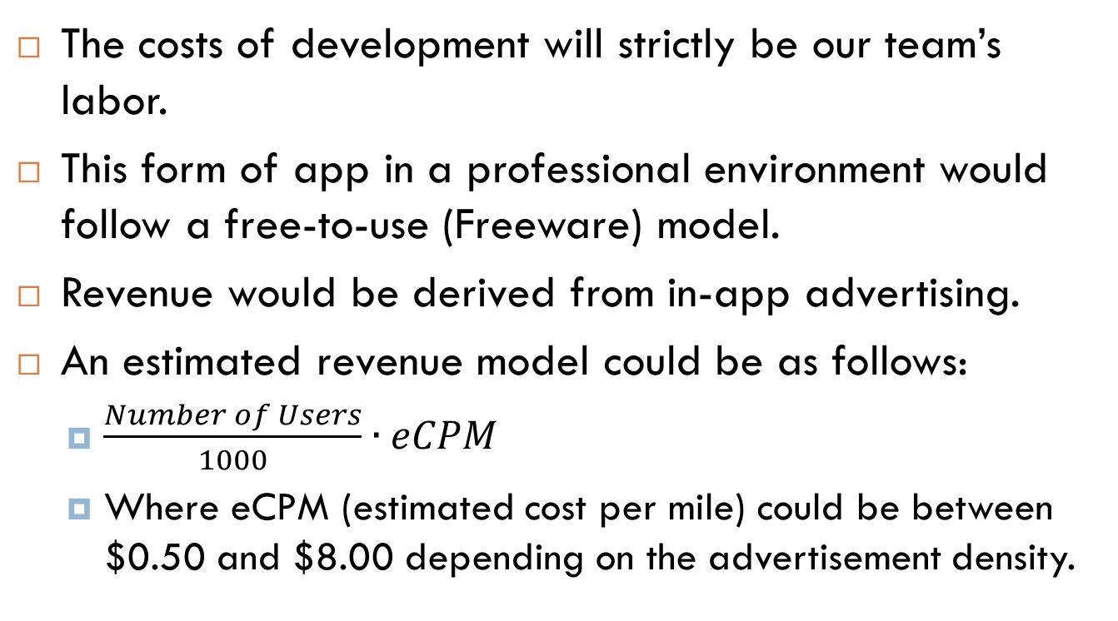
Costs/Revenue
The costs of development will strictly be our team’s labor.
This form of app in a professional environment would follow a free-to-use (Freeware) model.
Revenue would be derived from in-app advertising.
An estimated revenue model could be as follows:
$\frac{Number of Users}{1000}∙eCPM$
Where eCPM (estimated cost per mile) could be between $0.50 and $8.00 depending on the advertisement density.

Slide 10
Risks
Performance
Mobile apps require highly optimized algorithms to run smoothly.
This issue could be resolved through rigorous testing and careful planning.
Failure to implement all requirements
This risk could be resolved through careful planning, research, and organization.
Local Storage of Recipes
Migrating to a new phone would cause recipes to be lost.
This risk could be resolved by adding a backup feature or cloud save feature, if time provides.

Slide 11
Risk Assessment/Mitigation
Our Team will make use of Github, which is source control software, to keep track of issues and risks that may arrise.
If bugs or issues are found, new tickets will be opened in Github as an organizational tactic.
Communication will be our strongest application for ensuring that our project is developed smoothly.

